Slide 1

Energy Efficient
Campus

Slide 2
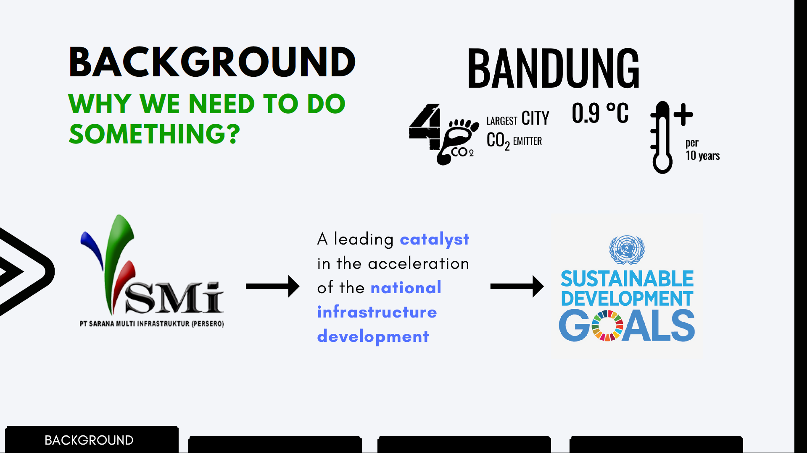
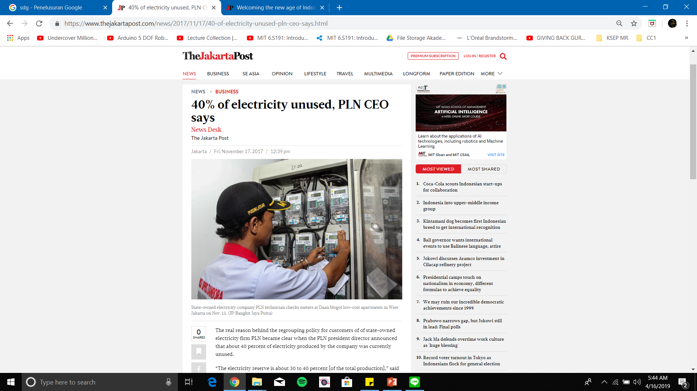


Slide 3

ITB
?
HOW
ABOUT

Slide 4
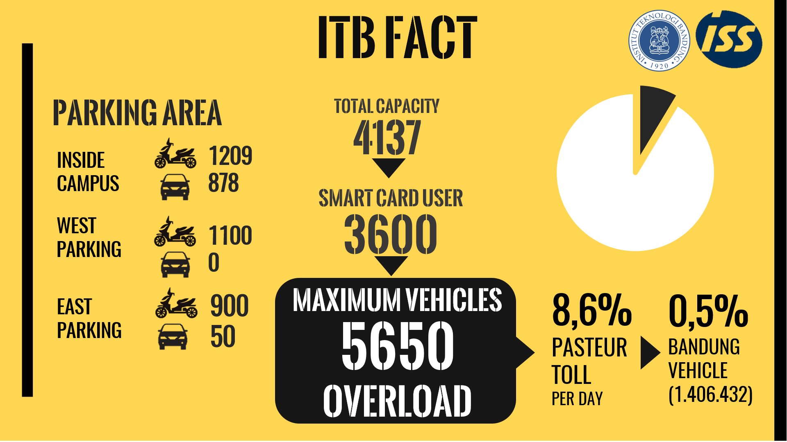

Slide 5
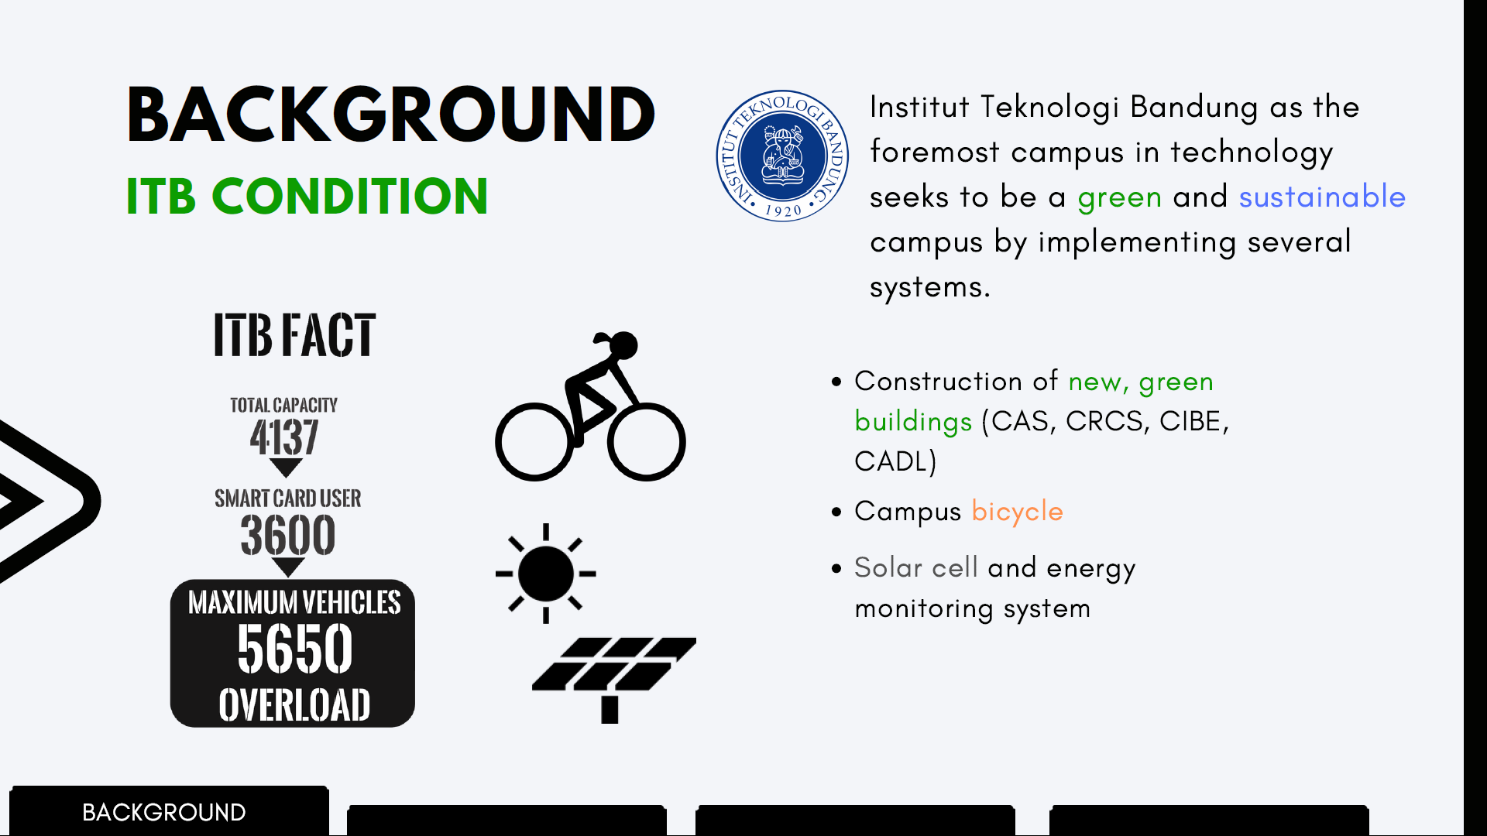

Slide 6


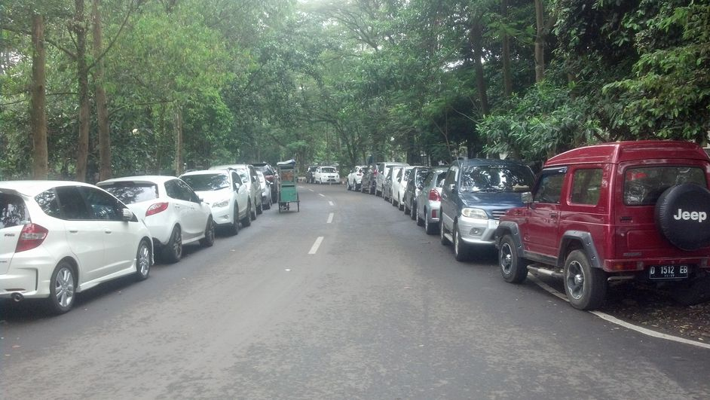
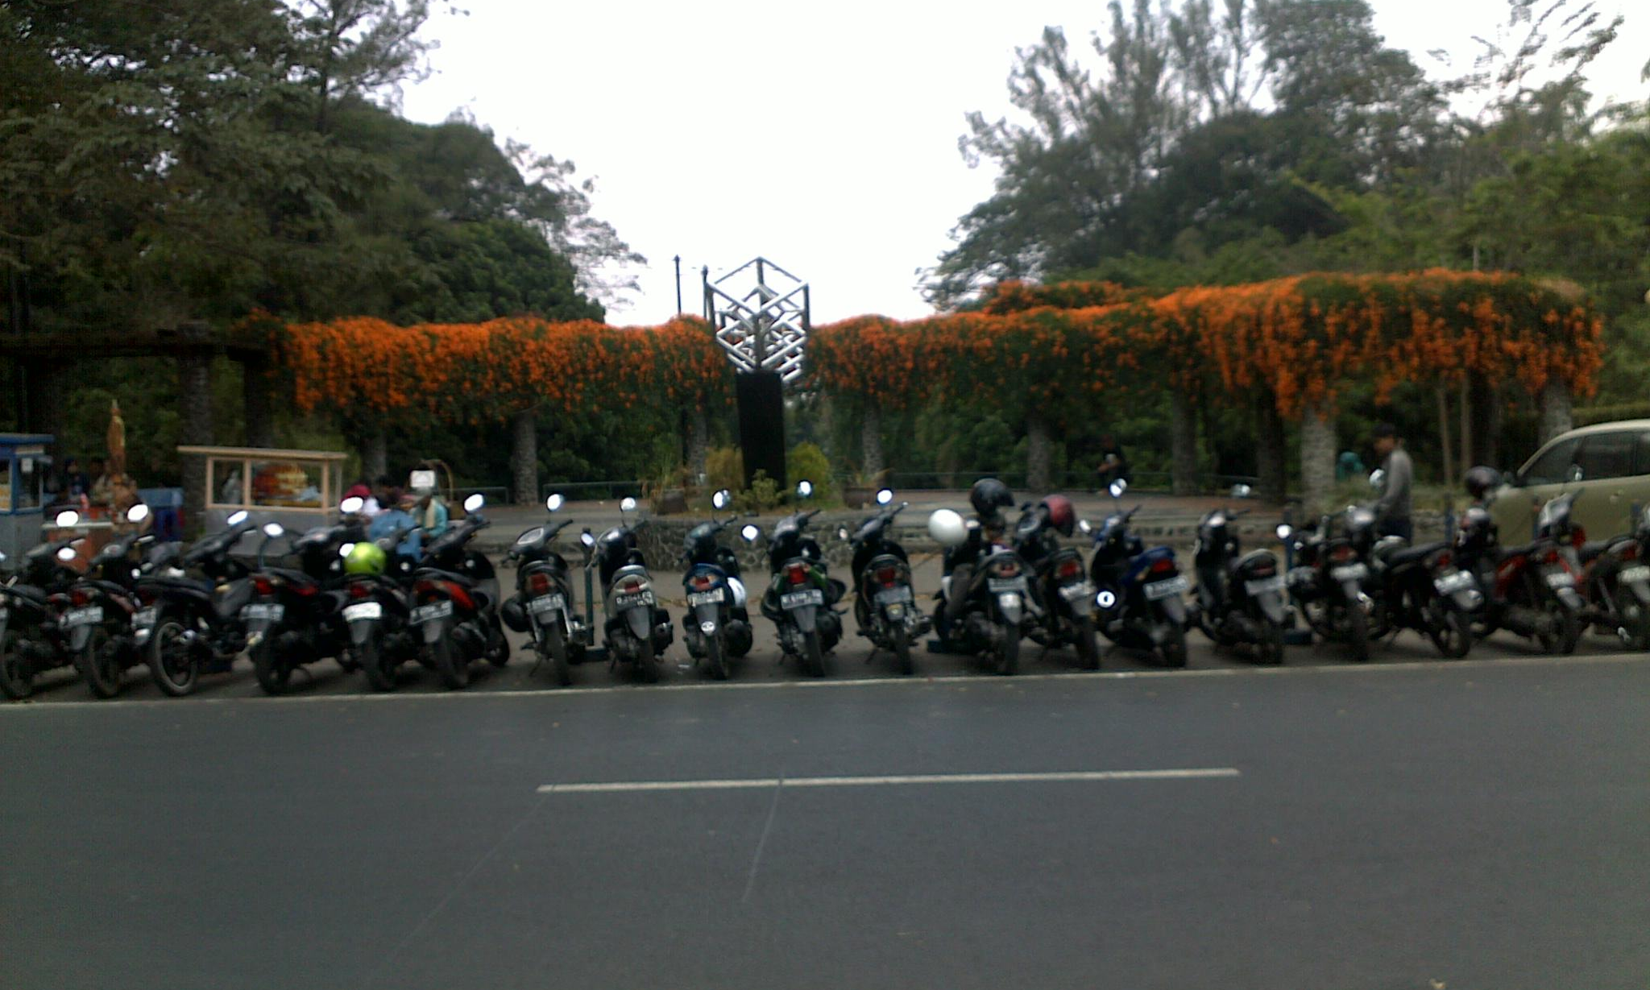
CARBON IN ITB?
INDONESIA NATIONAL STANDARD (SNI) 2002/51/EC
CO
2,62 g/km
CO₂
120 g/km
V average = 1,6 L
2,5% v/v
2,5% v/v
Total Vehicle in 1 year = 1.560.200 Vehicles
OUTSIDE CAMPUS?
Total Carbon = 594,6962 kg
= 0,6 ton /year carbon emission
62%
0,125%
INSIDE CAMPUS →
PARKING CONTRIBUTE
→
CAMPUS
CARBON EMISSION
BANDUNG
CARBON EMISSION

Slide 7



EXISTING SOLUTION
SMART CARD
BICYCLE

Slide 8
problems?

Slide 9








SMART
CARD
BICYCLE
STATION
DEPENDENCY
STEEP CONTOUR
INSUFFICIENT LUGGAGE
LIMITED ACCESS
TIME CONSUMING
ABANDONED
BIKES
ELDERLY
SAFETY

Slide 10
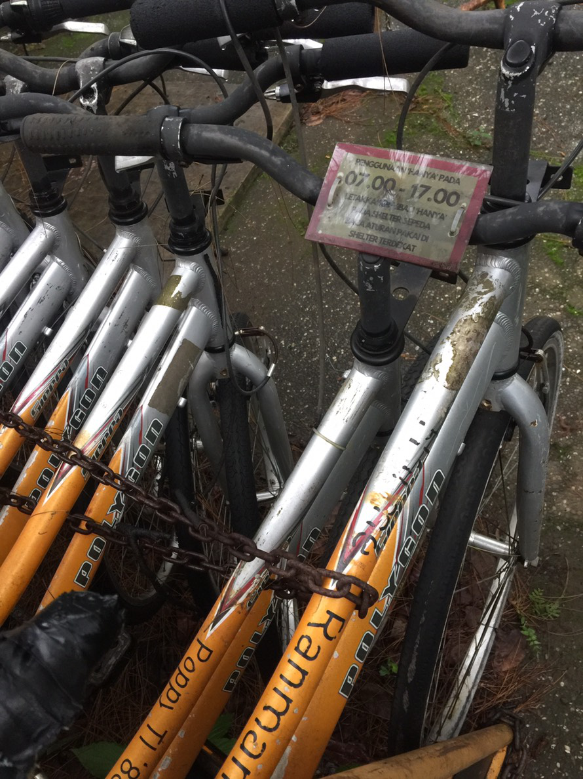
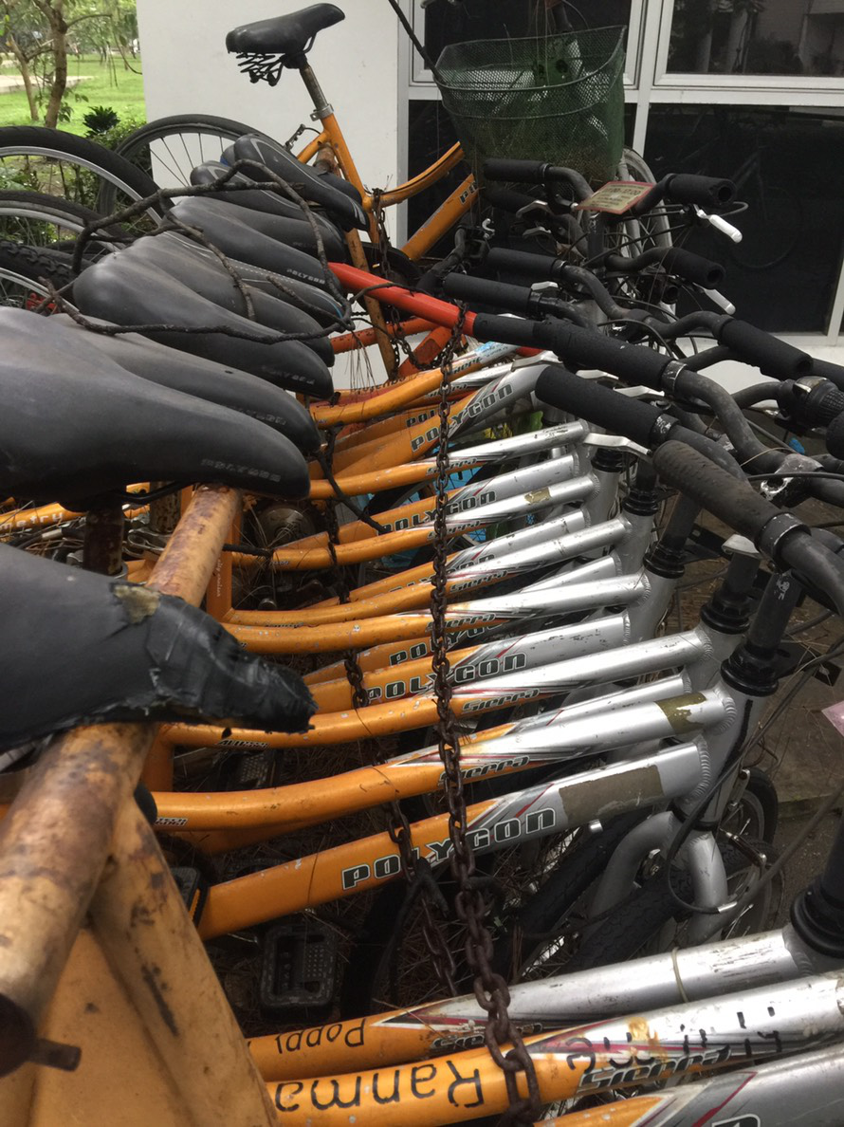
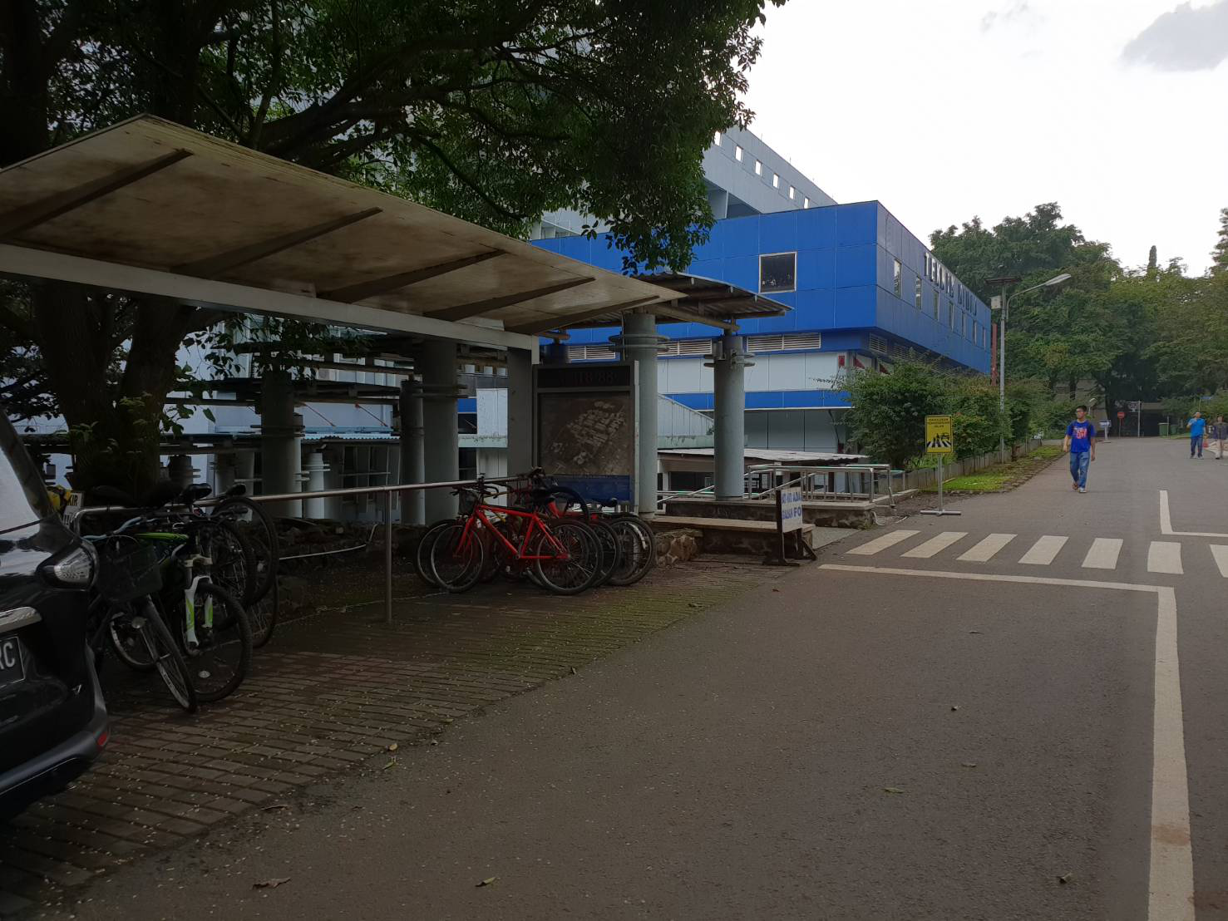
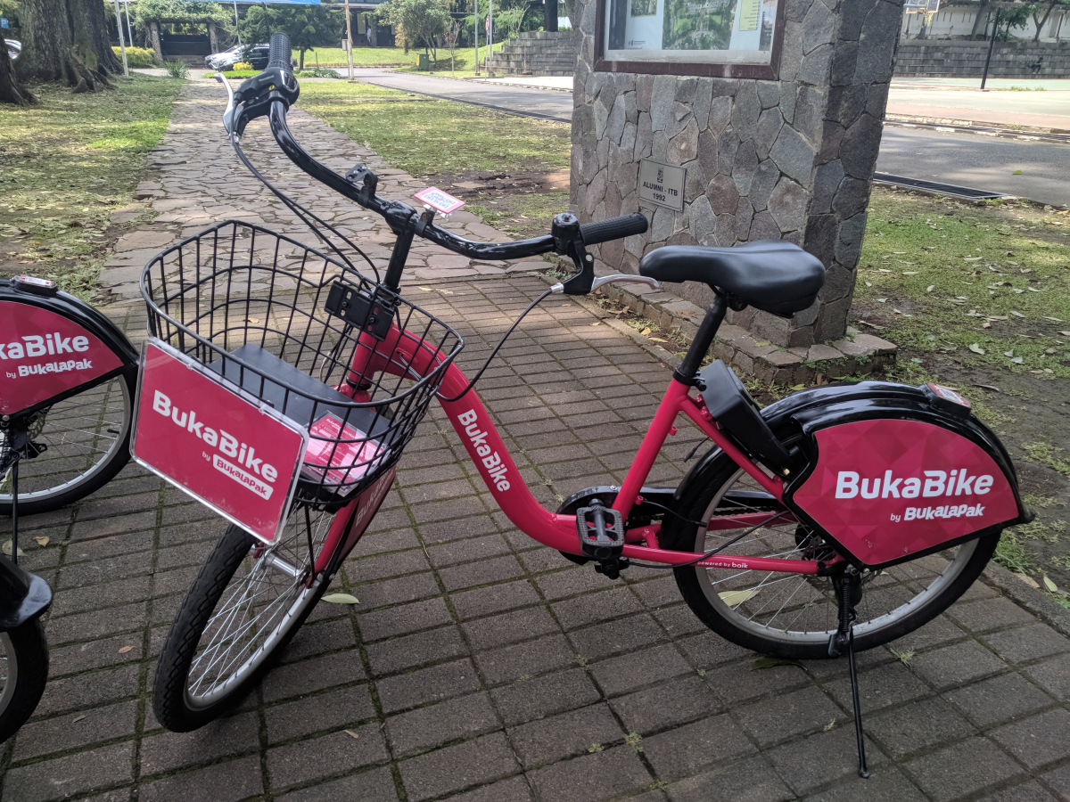

Slide 11
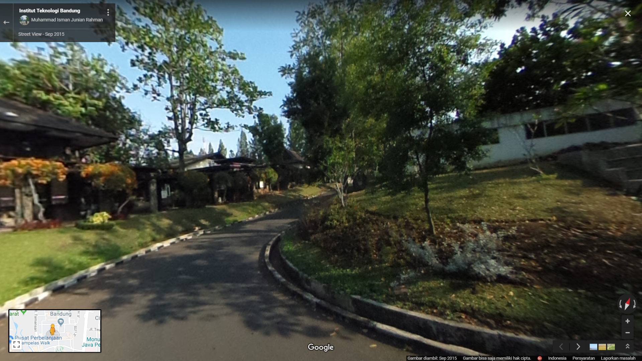
Elevation Angle~25°

Slide 12










WE have an idea
Time saving
safety
independency
REAL ACTION
&
FUTURISTIC WAY
Unlimited access
capacity

Slide 13


Slide 14
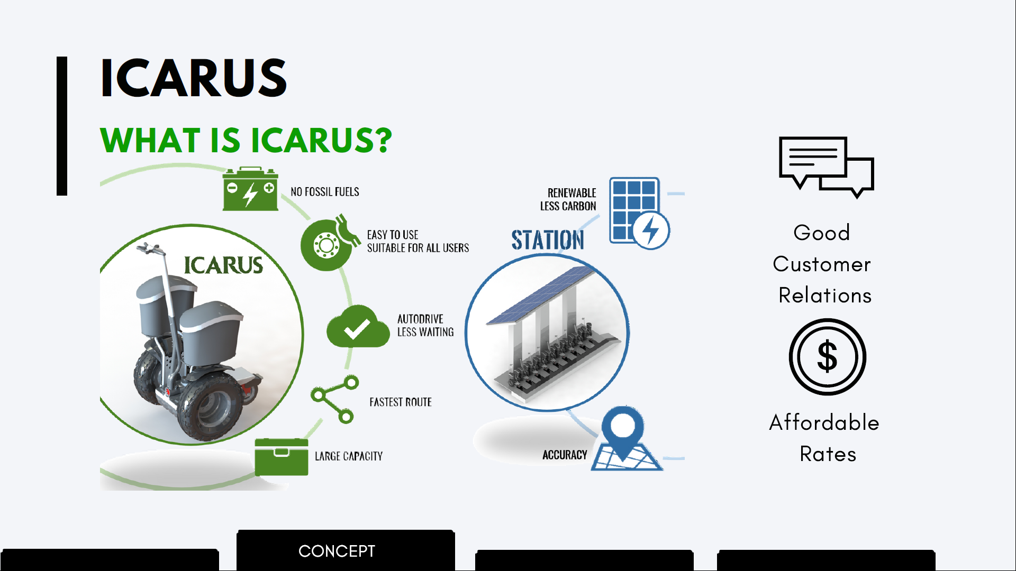
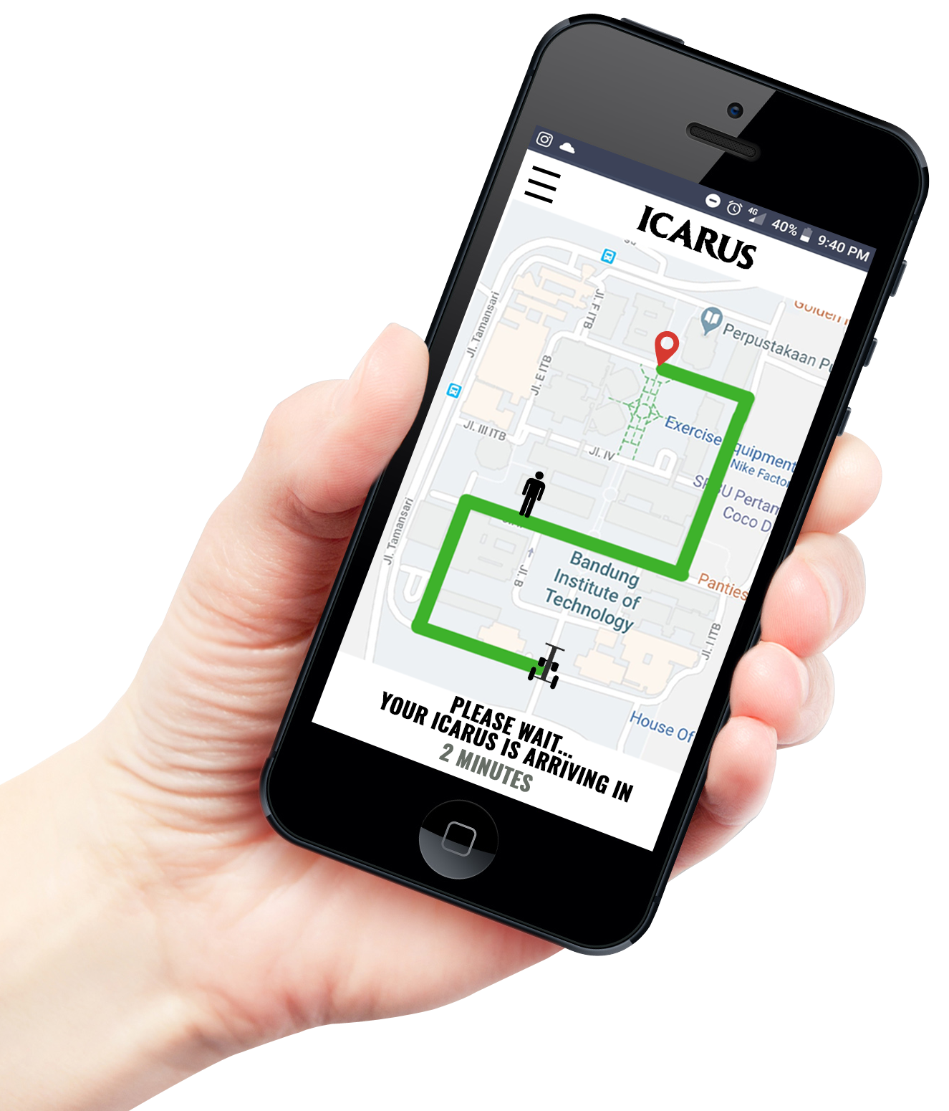

Slide 15

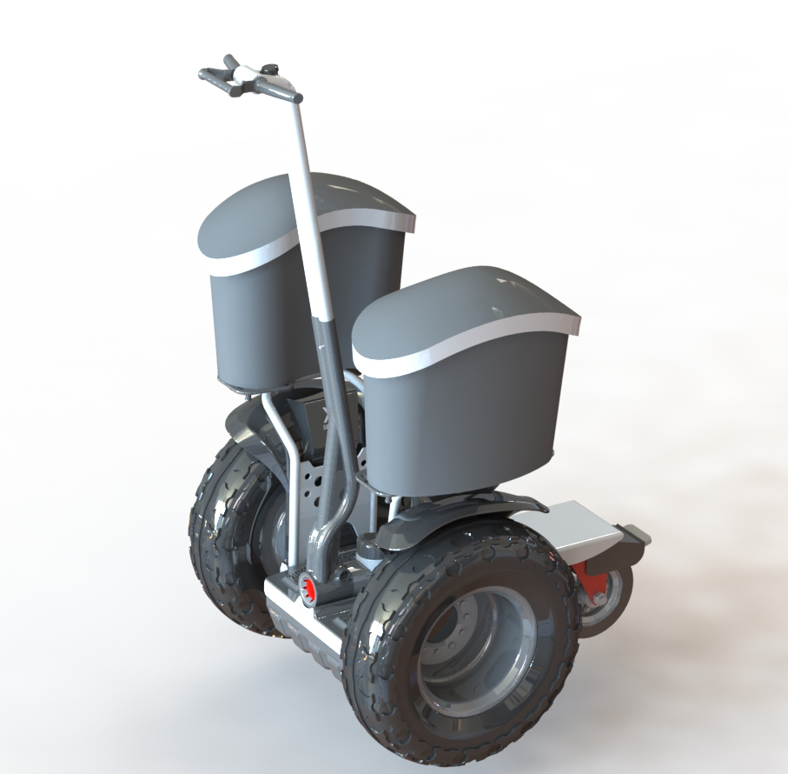





ORDER
AUTO DRIVE
RETURN TO STATION
SELF DISTRIBUTION

Slide 16


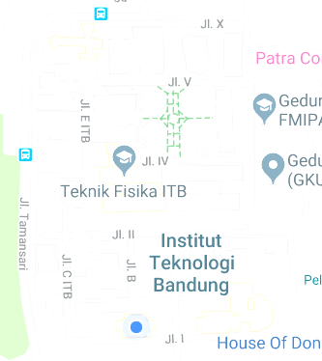





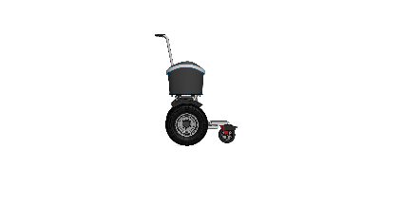




25
4
HIGH DEMAND
RETURN TO STATION
10
8
7
night time redistribution

Slide 17
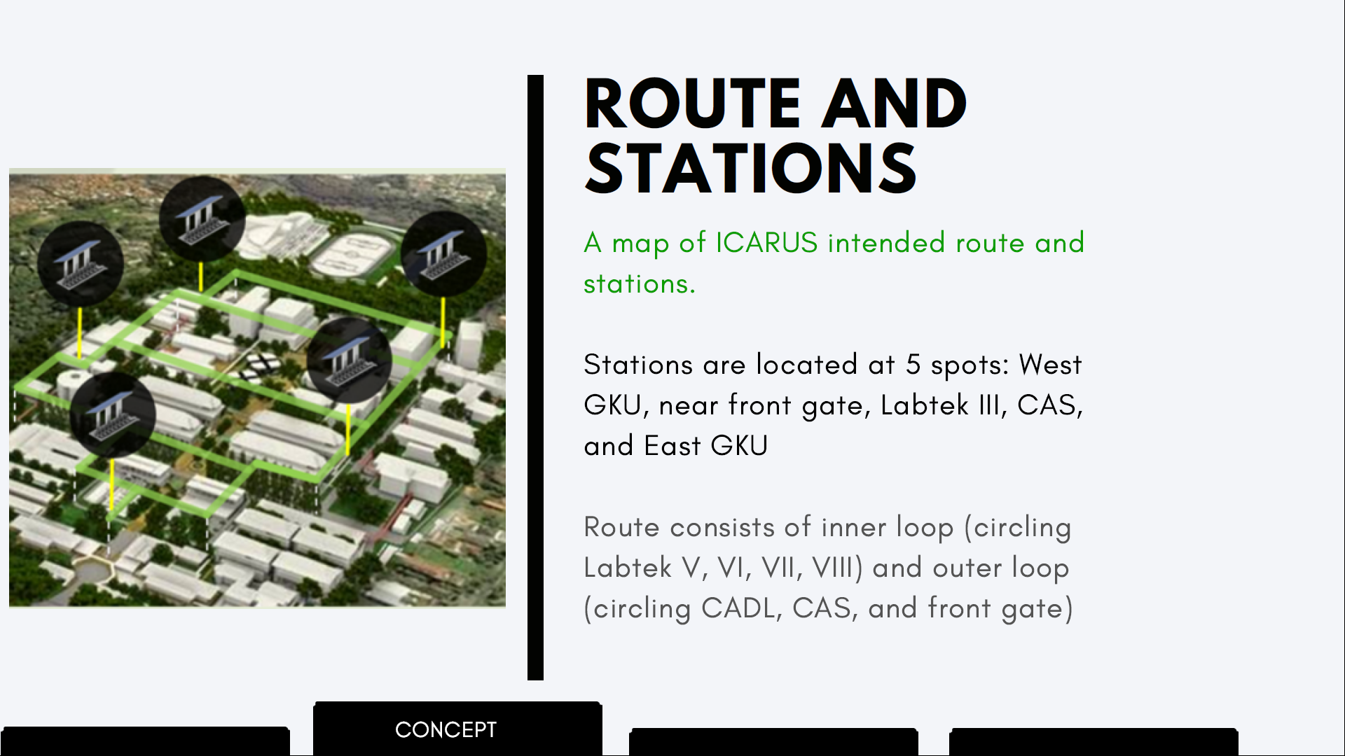

Slide 18
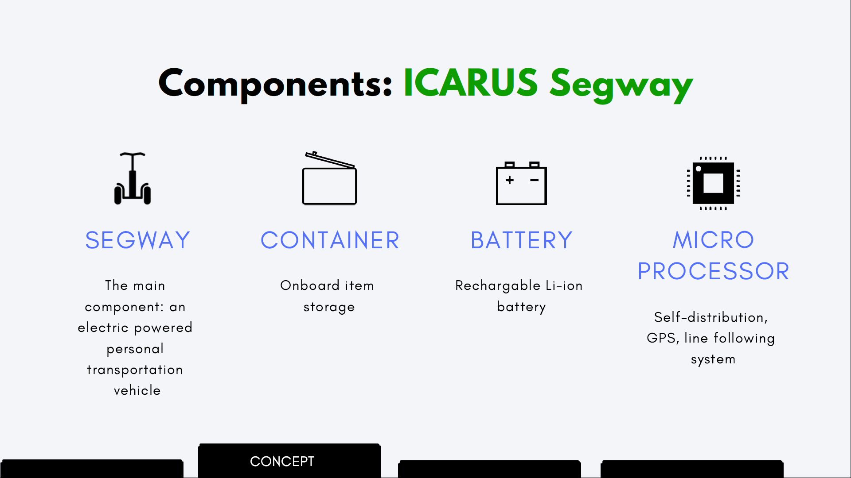

Slide 19
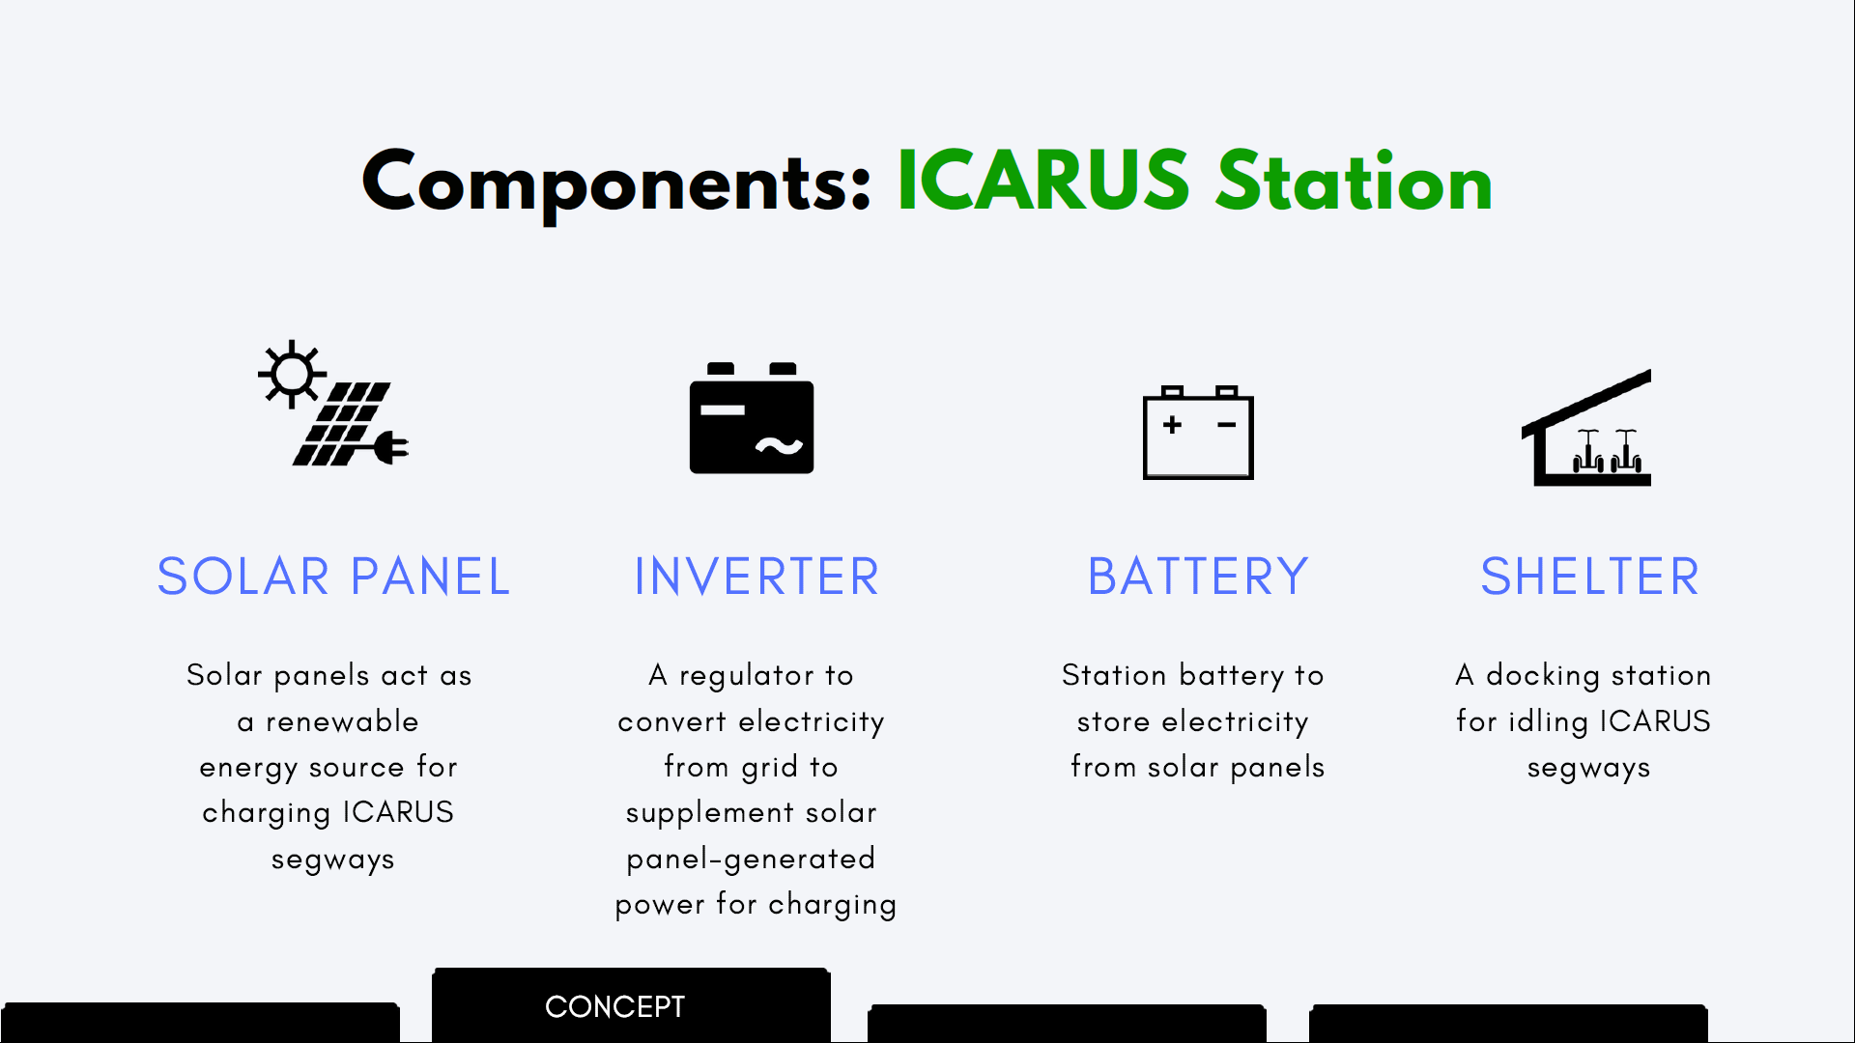

Slide 20
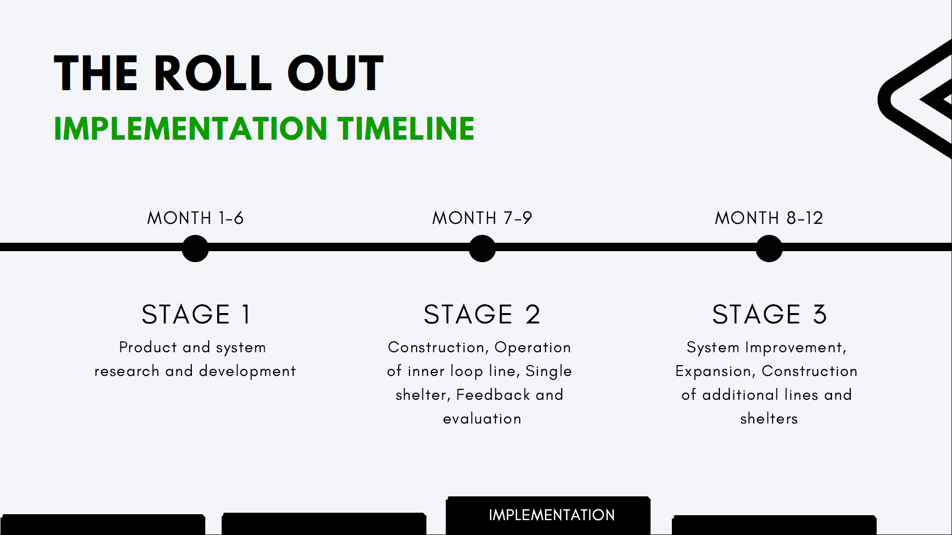

Slide 21
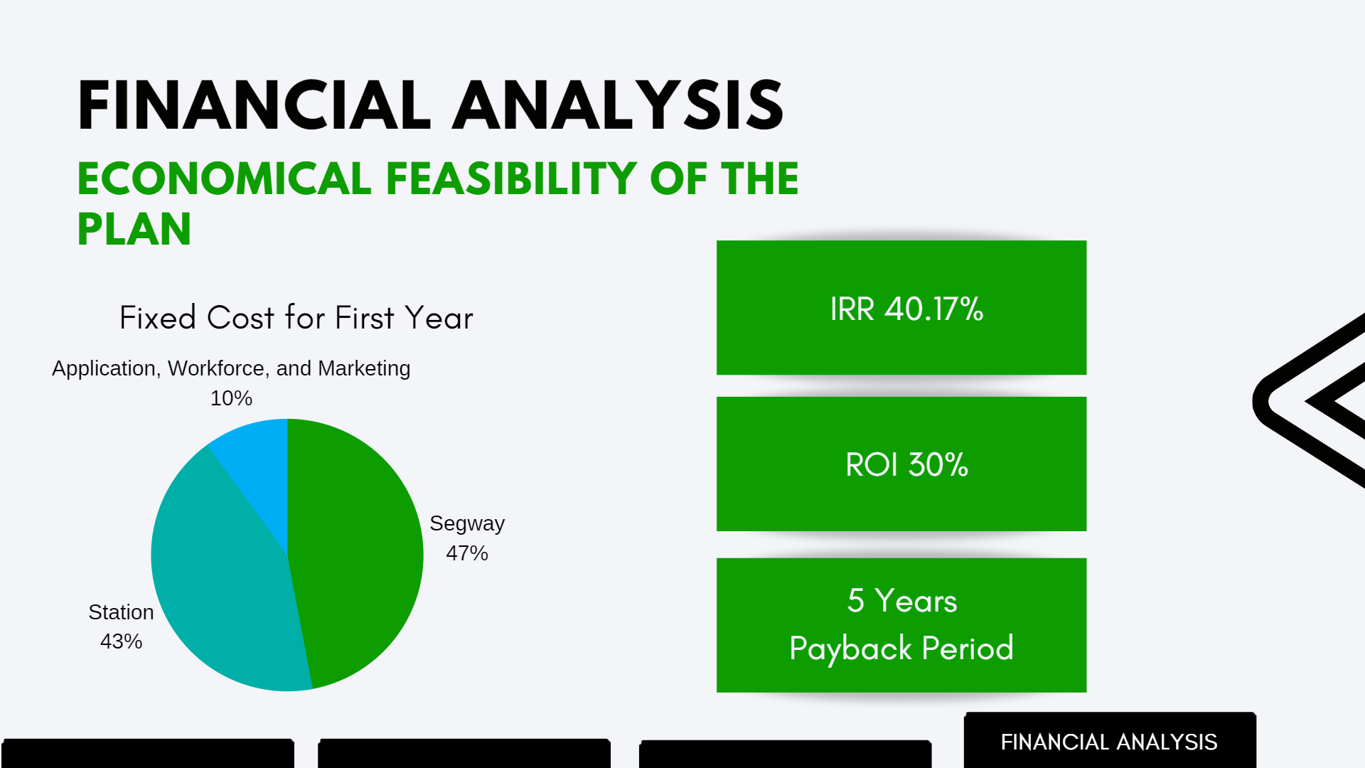
Rp 502.000.000,00

Slide 22
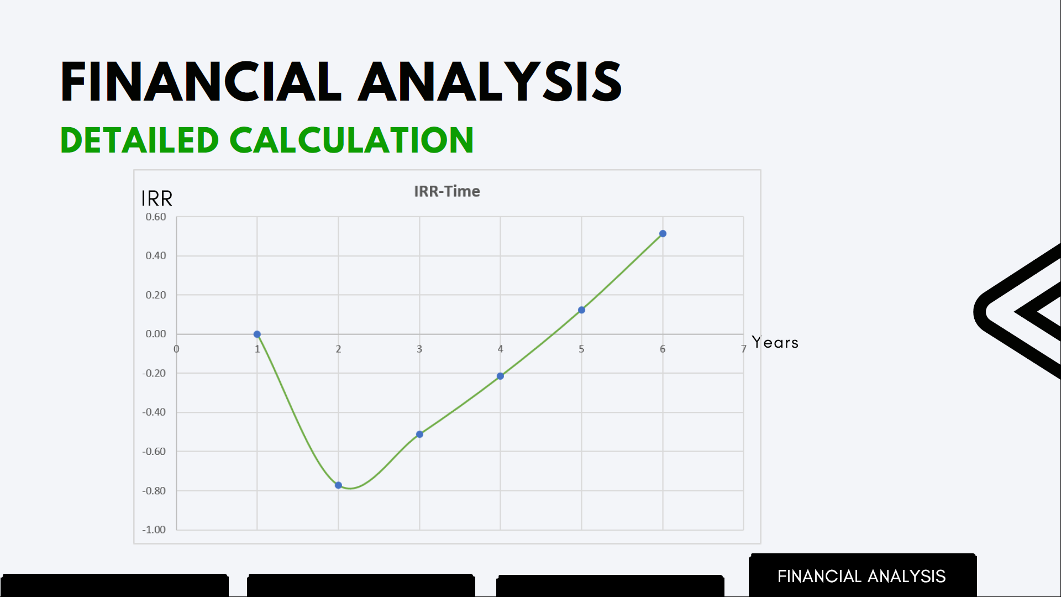

Slide 23
BIED Monthly Subscription Financial Analysis

Slide 24

Business Development Alternative Strategy | Revenue Collection Model
Buy-Implement-Evaluate-Develop Model | Monthly Subscription (Time Based Revenue Collection)
Research-Implement-Evaluate-Develop Model | Free Usage (No Revenue focused on Research and Development Purpose)
 | Per Trip Pricing (On Usage Revenue Collection)

Slide 25
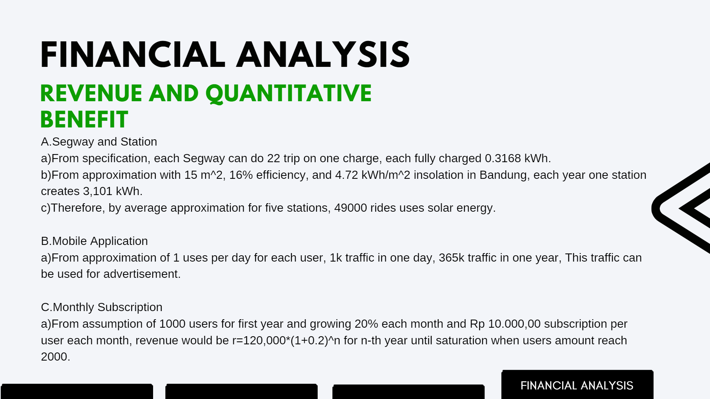
250 Wp for 1 Solar panel, 9 Solar panel for 15 m^2.

Slide 26
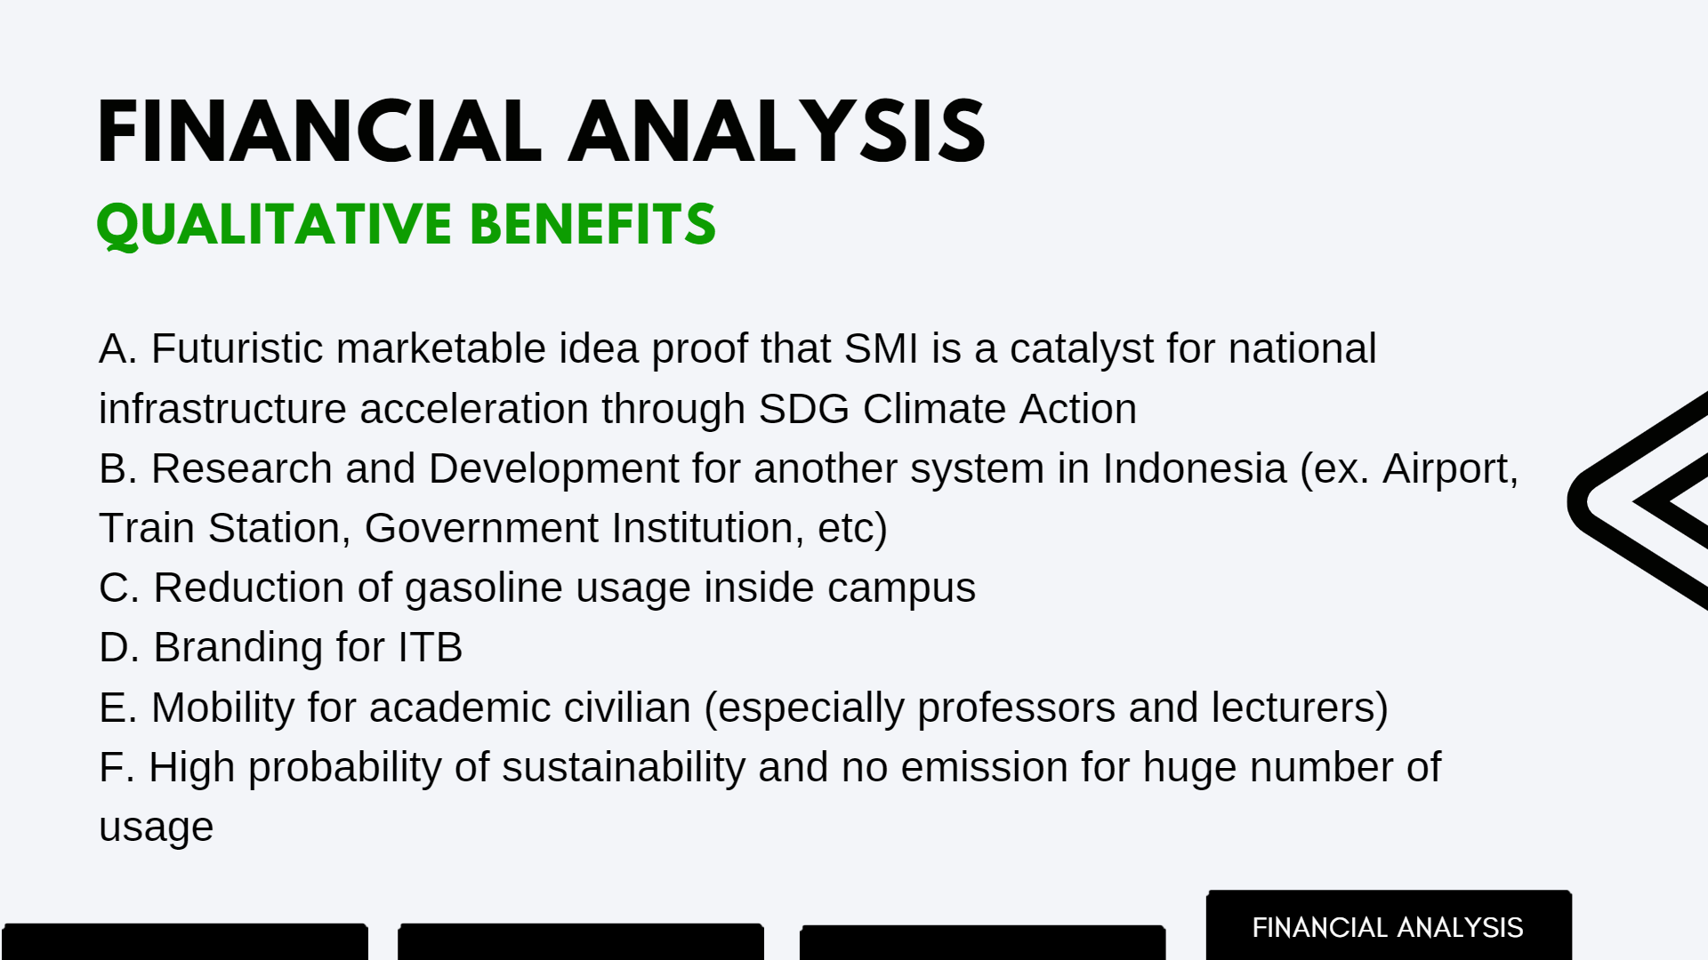
ITB

Slide 27
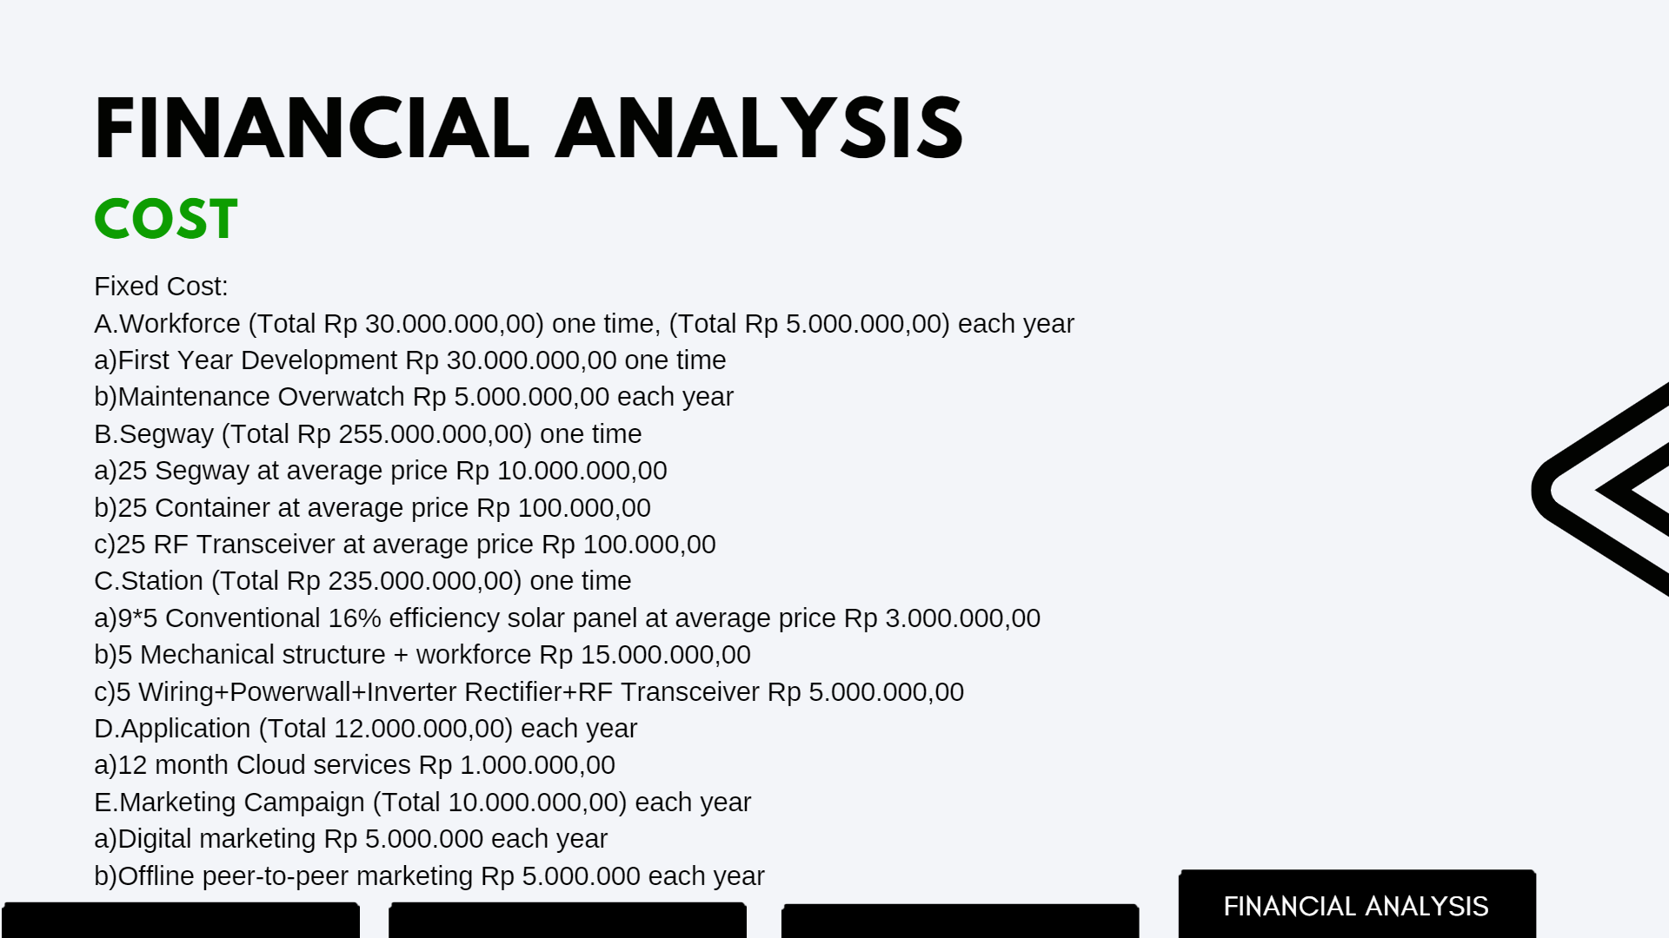

Slide 28
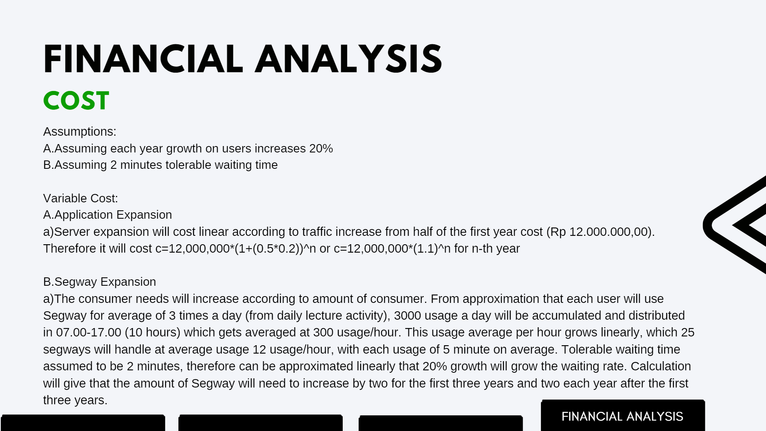

Slide 29
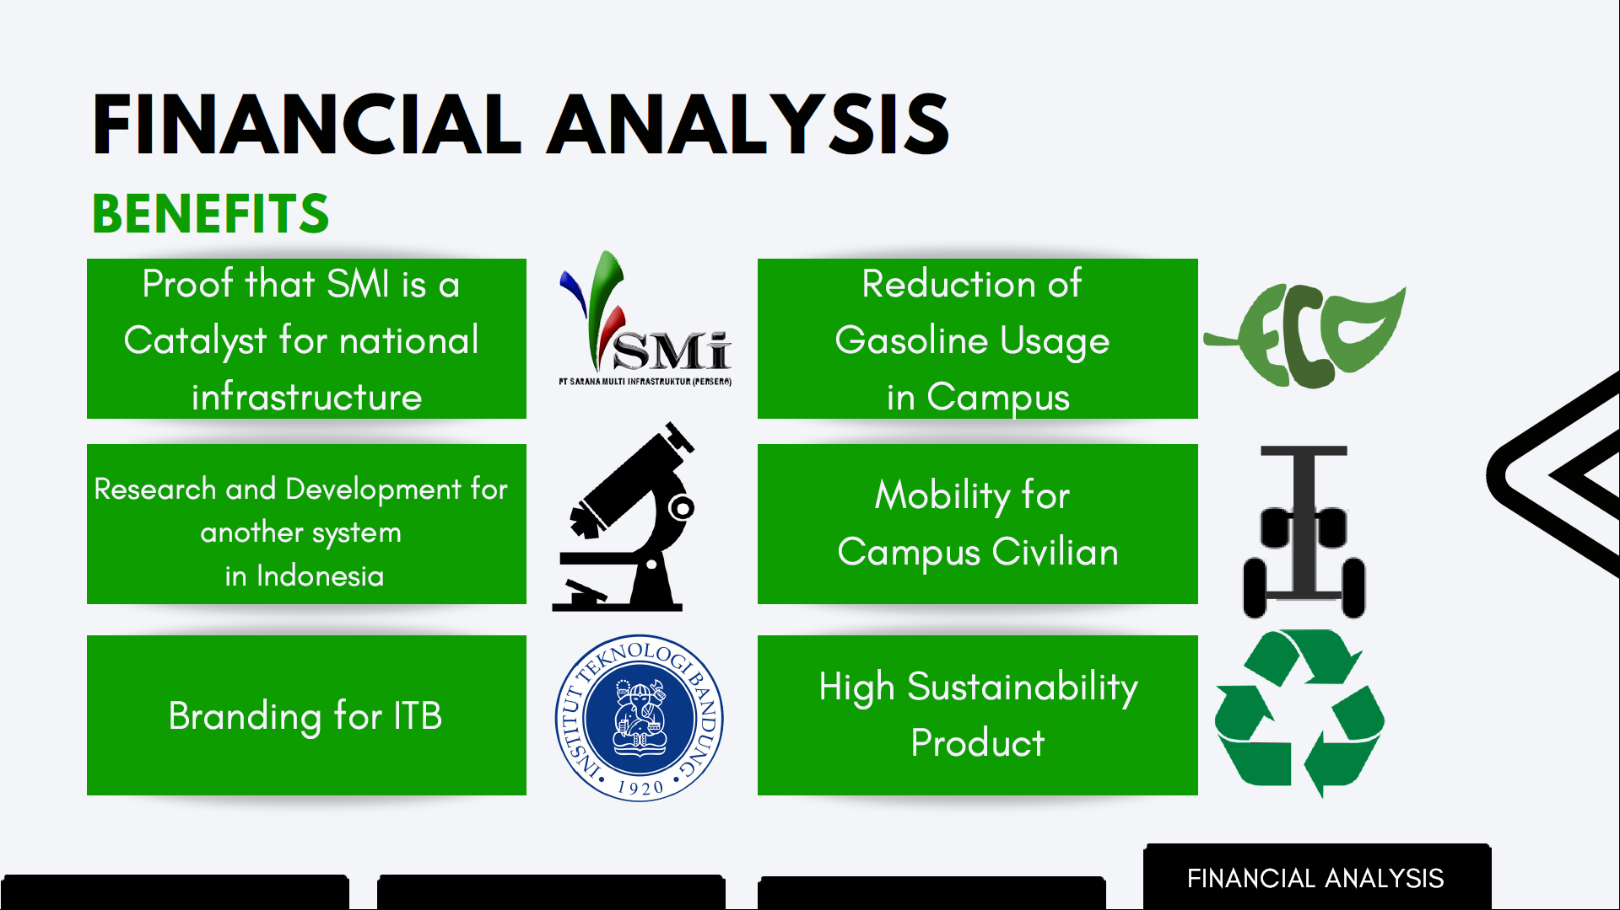
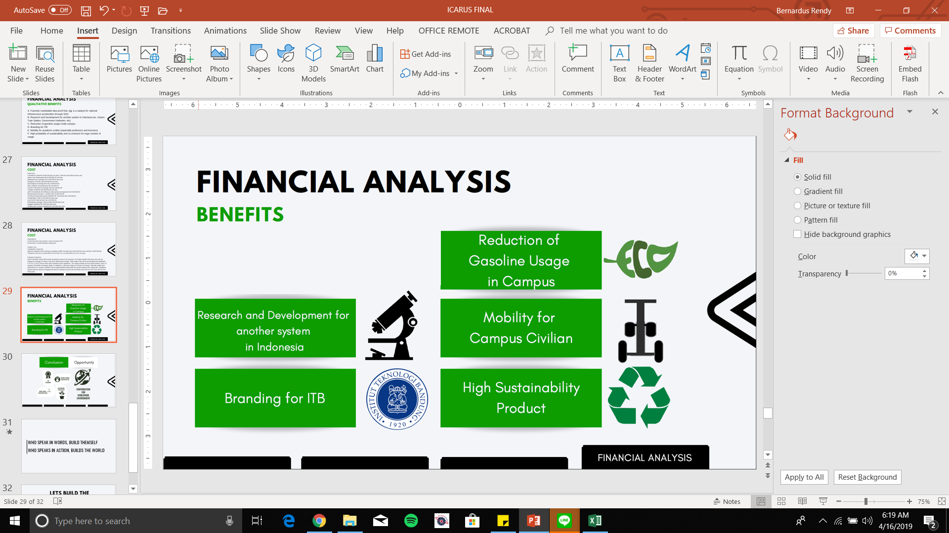

Slide 30
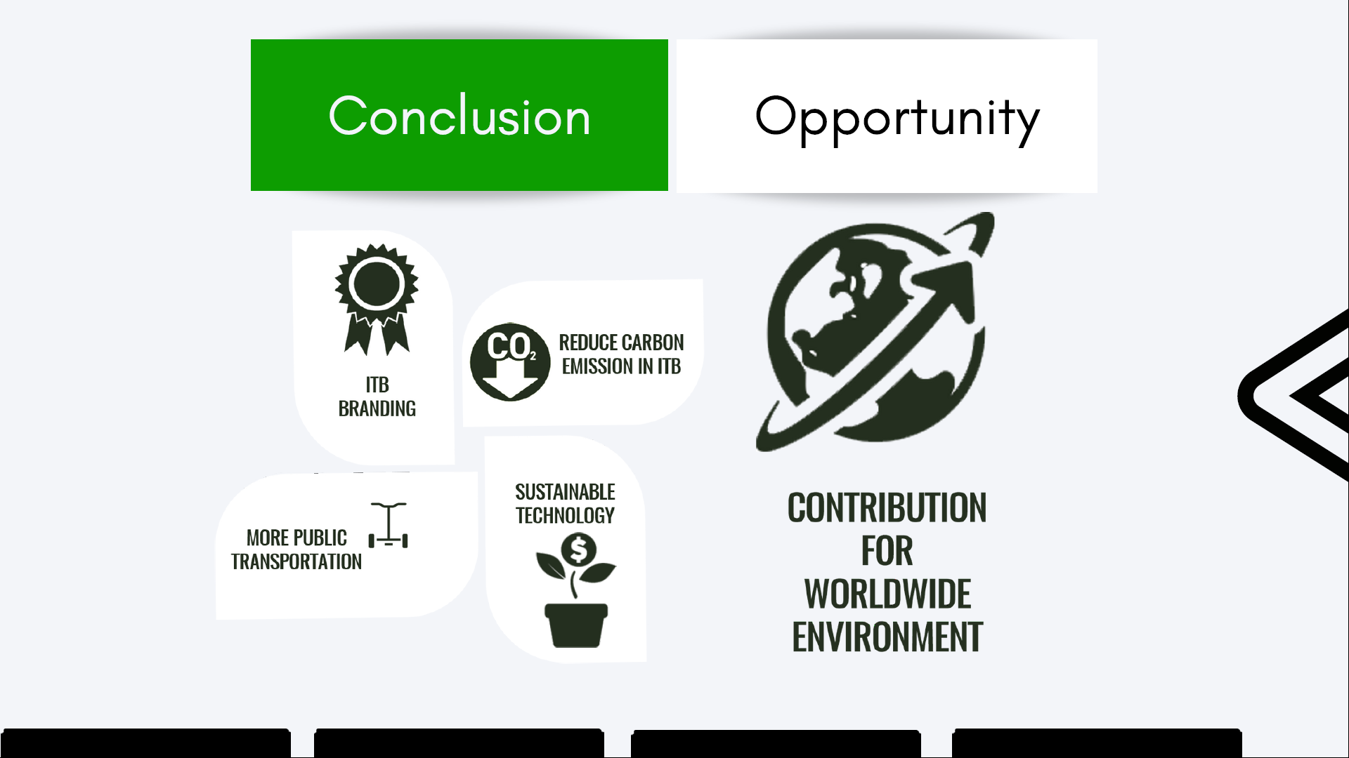

Slide 31
WHO SPEAK IN WORDS, BUILD THEMSELF WHO SPEAKS IN ACTION, BUILDS THE WORLD

Slide 32


